Slide 1
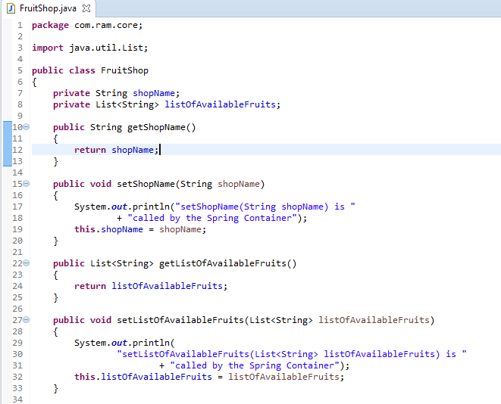
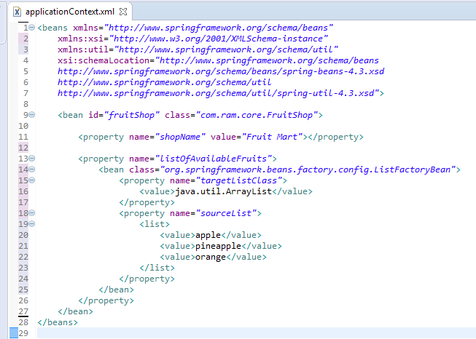
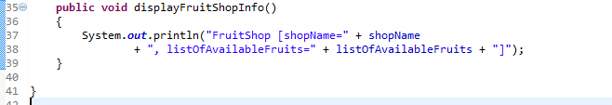
ListFactoryBean to create a concrete List collection class (ArrayList and LinkedList)
We can use ListFactoryBean to create a concrete List collection class (ArrayList and LinkedList) in Spring’s bean configuration file.
ListFactoryBean will instantiate an ArrayList at runtime, and inject it into a bean property.

Slide 2
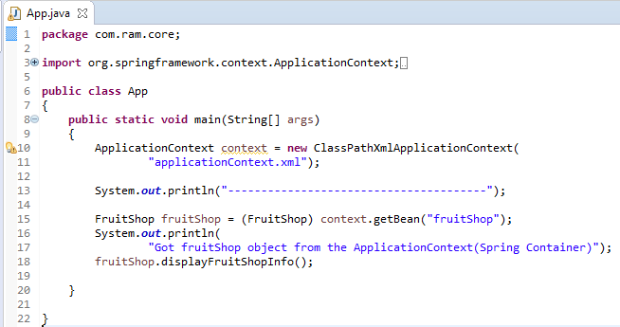
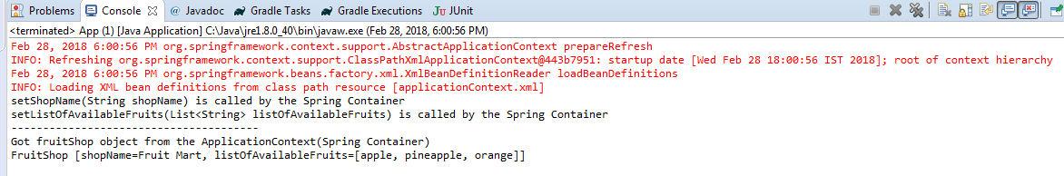
ListFactoryBean to create a concrete List collection class (ArrayList and LinkedList)

